Slide 1
Software Testing

Slide 2
Software Testing
The aim of Software testing is:
1. Show that a program does what it is intended to do
.ie demonstrate to the developer and customer that the product meets the requirements (validation testing)
2. To discover program defects before it is put into use.
Ie Rooting out undesirable system behavior such as system crashes, unwanted interactions with other systems, incorrect computations, and data corruption (defect testing)

Slide 3
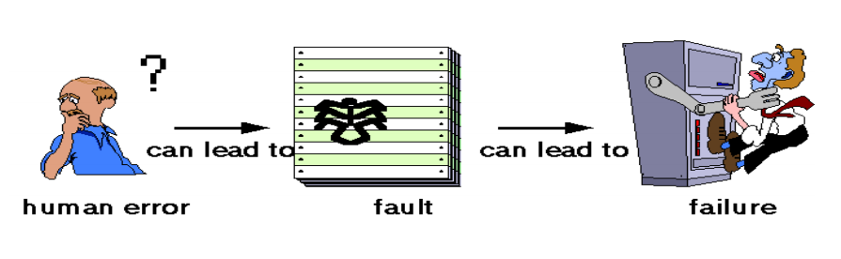
Software Testing Basics

Slide 4
Software Testing Basics
Failure: Observable incorrect behavior
Fault/bug- Incorrect code
Error- Cause of a fault

Slide 5
Software Testing Basics
A program was created to get the double value of numbers.
Using the code, a call to doublevalue(3) returrns 9. This is:
A. Fault
B. Failure
C. An error
Int doublevalue ( int i){
Int result;
result-=i*i;
return result;
}

Slide 6
Software Testing Basics
A program was created to get the double value of numbers.
Where is the fault that causes the failure?( state the line of code)
What is the error that caused the fault?
Int doublevalue ( int i){
Int result;
result-=i*i;
return result;
}

Slide 7
Software Testing Basics
Defect
Defect is the variance from a desired product attribute (it can be a wrong, missing or extra data).
It is a flaw in the software system and has no impact until it affects the user/customer and operational system. 90% of all the defects can be caused by process problems.

Slide 8
Software Testing Basics
• Quality Assurance:
Is oriented towards preventing defects.
Quality Assurance ensures all parties concerned with the project adhere to the process and procedures, standards and templates and test readiness reviews.
• Quality Control: quality control or quality engineering is a set of measures taken to ensure that defective products or services are not produced, and that the design meets performance requirements

Slide 9
Software Testing
Testing cannot demonstrate that the software is free of defects or that it will behave as specified in every circumstance.
It is always possible that a test that you have overlooked could discover further problems with the system.
As Edsger Dijkstra, an early contributor to the development of software engineering, eloquently stated (Dijkstra et al., 1972):
“Testing can only show the presence of errors, not their absence

Slide 10
Software Testing
Testing is a broader process of verification and validation
Verification: “Are we building the product right”
The software should conform to its specification.
Validation: “Are we building the right product”
The software should do what the user really requires.
Verification and validation processes are concerned with checking that software being developed :
Meets its specification and delivers the functionality expected by the people paying for the software.
It establishes confidence that software is fit for purpose

Slide 11
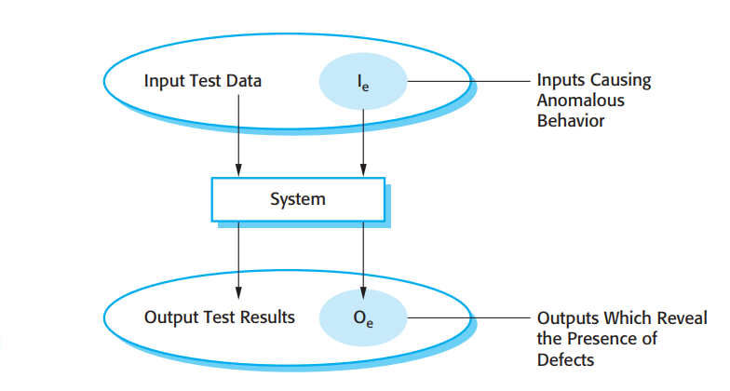
Software Testing
Validation and defect testing

Slide 12
Software Testing Stages
A commercial software system has to go through three stages of testing:
1. Development testing
2. Release Testing
3. User Testing

Slide 13
Software Testing
1. Development testing,
The system is tested during development to discover bugs and defects.
System designers and programmers are likely to be involved in the testing process.

Slide 14
Software Testing
2. Release testing,
A separate testing team tests a complete version of the system before it is released to users.
The aim of release testing is to check that the system meets the requirements of system stakeholders.

Slide 15
Software Testing
3. User testing
Users or potential users of a system test the system in their own environment.
For software products, the ‘user’ may be an internal marketing group who decide if the software can be marketed, released, and sold.
Acceptance testing is one type of user testing where the customer formally tests a system to decide if it should be accepted from the system supplier or if further development is required

Slide 16
Development Testing

Slide 17
Development Testing
Development testing includes all testing activities that are carried out by the team developing the system.
During development, testing may be carried out at three levels of granularity:
1. Unit Testing
2. Component Testing
3. System Testing

Slide 18
Development Testing
1. Unit testing
Where individual program units or object classes are tested.
Unit testing should focus on testing the functionality of objects or methods.
2. Component testing
Where several individual units are integrated to create composite components.
Component testing should focus on testing component interfaces.
3. System testing
Where some or all of the components in a system are integrated and the system is tested as a whole. System testing should focus on testing component interactions

Slide 19
Unit Testing
The process of testing program components such as methods or object classes.
Tests should provide coverage to all features of the object, they should:
1. Test all operations associated with the object;
2. Set and check the value of all attributes associated with the object;
3. Put the object into all possible states. This means that you should simulate all events that cause a state change

Slide 20
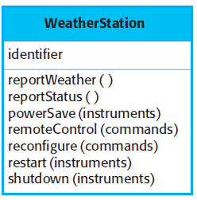
Unit Testing
Consider the object class weather station
Define all test cases for all methods associated with the object
Use a state model to test the different states of the weather station

Slide 21
Unit Testing
Unit testing can be automated, where you make use of a test automation framework (such as JUnit) to write and run your program tests.
Unit testing frameworks provide generic test classes that you extend to create specific test cases.
They can then run all of the tests that you have implemented and report, often through some GUI, on the success or failure of the tests

Slide 22
Unit Testing
Unit test cases should be effective
1. The test cases should show that, when used as expected, the component that you are testing does what it is supposed to do.
2. If there are defects in the component, these should be revealed by test cases.

Slide 23
Component Testing
Software components are often composite components that are made up of several interacting objects.
The functionality of these objects are defined through a component interface
Component interface testing involves identifying errors resulting from interactions between the objects in the component.

Slide 24
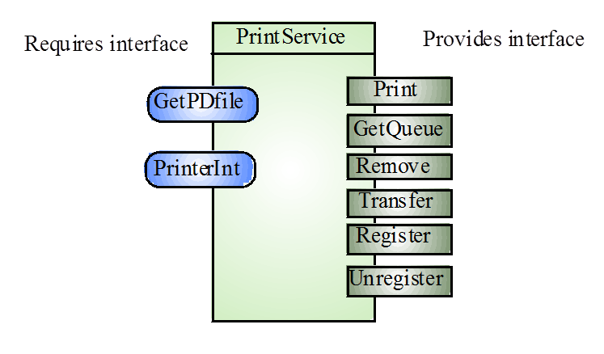
Example: Printing services component
Provides interface
Defines the services that are provided by the component to other components
Requires interface
Defines the services that specifies what services must be made available for the component to execute as specified

Slide 25
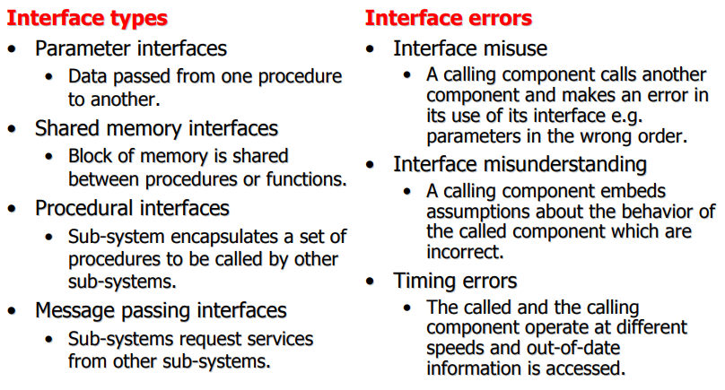
Interface types and errors
There are different types of interface between program components and, consequently, different types of interface error that can occur

Slide 26
System Testing
System testing during development involves integrating components to create a version of the system and then testing the integrated system.
System testing checks that :
1. Components are compatible
2. Components interact correctly
3. Components transfer the right data at the right time across their interfaces.

Slide 27
System Testing
During system testing:
1. Reusable components that have been separately developed and off-the-shelf systems may be integrated with newly developed components.
The complete system is then tested
Components developed by different team members or groups may be integrated at this stage

Slide 28
Test Driven Development

Slide 29
Test Driven Development
Test-driven development (TDD) is an approach to program development in which you interleave testing and code development.
You develop the code incrementally, along with a test for that increment.
You don’t move on to the next increment until the code that you have developed passes its test

Slide 30
Test Driven Development
To write a test, you need to completely understand what is intended to do
For example,
If your computation involves division, you should check that you are not dividing the numbers by zero.
If you forget to write a test for this, then the code to check will never be included in the program

Slide 31
Benefits of test driven development
1. Code coverage
In principle, every code segment that you write should have at least one associated test.
Therefore, you can be confident that all of the code in the system has actually been executed.
Code is tested as it is written so defects are discovered early in the development process.

Slide 32
Benefits of test driven development
2. Regression testing
A test suite is developed incrementally as a program is developed.
You can always run regression tests to check that changes to the program have not introduced new bugs

Slide 33
Benefits of test driven development
3. Simplified debugging
When a test fails, it should be obvious where the problem lies.
The newly written code needs to be checked and modified.
You do not need to use debugging tools to locate the problem.
Reports of the use of test-driven development suggest that it is hardly ever necessary to use an automated debugger in test-driven development (Martin, 2007

Slide 34
Release Testing

Slide 35
Release Testing
Release testing is the process of testing a particular release of a system that is intended for use outside of the development team. It involves:
A separate team that has not been involved in the system development should be responsible for release testing.
System testing by the development team should focus on discovering bugs in the system (defect testing).
The objective of release testing is to check that the system
meets its requirements and is good enough for external use (validation testing)

Slide 36
Performance Testing
Performance tests have to be designed to ensure that the system can process its intended load.
This usually involves running a series of tests where you increase the load until the system performance becomes unacceptable.
This type of testing has two functions:
It tests the failure behavior of the system
It stresses the system and may cause defects to come to light that would not normally be discovered.

Slide 37
Performance Testing
Stress Testing
Exercises the system beyond its maximum design load. Stressing the system often causes defects to come to light
Stress testing helps you discover when the degradation begins so that you can add checks to the system to reject transactions beyond this point.
Stress testing is particularly relevant to distributed systems t levant to distributed systems that can hat can exhibit severe degradation as exhibit severe degradation as a network becomes overloaded. a network becomes overloaded.

Slide 38
User Testing

Slide 39
User Testing
User or customer testing is a stage in the testing process in which users or customers provide input and advice on system testing
This may involve:
1. Formally testing a system that has been commissioned from an external supplier, or could be
2. An informal process where users experiment with a new software product to see if they like it and that it does what they need

Slide 40
User Testing
1. Alpha testing, where users of the software work with the development team to test the software at the developer’s site.
2. Beta testing, where a release of the software is made available to users to allow them to experiment and to raise problems that they discover with the system developers.
3. Acceptance testing, where customers test a system to decide whether or not it is ready to be accepted from the system developers and deployed in the customer environment.

Slide 41
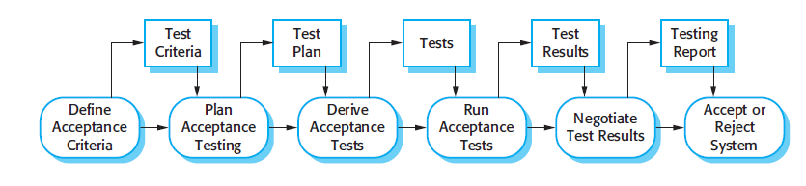
User Testing
There are six stages in the acceptance testing process, which include:

Slide 42
User Testing
1. Define Acceptance Criteria
2. Plan acceptance testing
This involves deciding on the resources, time, and budget for acceptance testing and establishing a testing schedule
3. Derive acceptance tests
Once acceptance criteria have been established, tests have to be designed to check whether or not a system is acceptable

Slide 43
User Testing
4. Run acceptance tests The agreed acceptance tests are executed on the system.
Ideally, this should take place in the actual environment where the system will be used, but this may be disruptive and impractical.
5. Negotiate test results
It is very unlikely that all of the defined acceptance tests will pass and that there will be no problems with the system.
In such cases, the developer and the customer have to negotiate to decide if the system is good enough to be put into use.

Slide 44
User Testing
Reject/accept system
This stage involves a meeting between the developers and the customer to decide on whether or not the system should be accepted.

